Slide 1
Computer Organization and Architecture
CST 202
Module - V
The Memory System & Cache
Fundamental Concepts
Semiconductor RAM memories
Read-Only Memories
Cache Memories

Slide 2
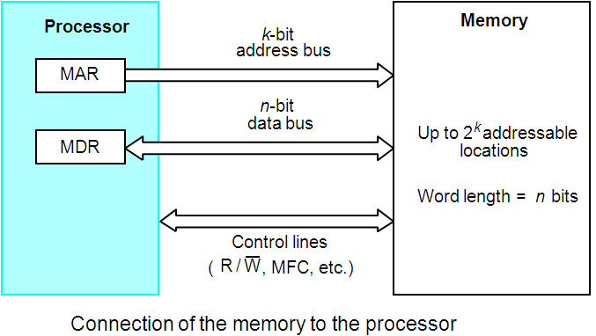
Some basic concepts
Maximum size of the Main Memory
Byte-addressable
CPU - Main Memory Connection
k- address bits => 2^{k} addressable locations
Word-length => n-bits

Slide 3
Data transfer between memory and the processor takes place through the use of 2 processor registers
  MAR – Memory address register
  MDR – Memory Data Register
If MAR is k bits long and MDR n bits long
  Memory unit may contain up to 2^{k} addressable locations
  During a memory cycle, n bits of data are transferred between memory and the processor
No of address lines = k- address bits => 2^{k} addressable locations
No of data lines = n bits =>(Word-length)
There are additional control lines read/write, MFC, no of bytes to be transferred etc

Slide 4
Memory Read and Write
Memory READ operation
Loads the address of the required memory location into MAR
Sets R/W line to 1
The memory responds by placing the requested data on data lines
  Confirms this action by asserting MFC signal
Upon receipt of MFC signal, processor loads the data on the data lines in to the MDR register
Memory WRITE operation
Loads the address of the location into MAR
Loads the data into MDR
Indicates Write operation by setting R/W line to 0
Wait for MFC

Slide 5
Random Access Memory (RAM)
A memory unit is called a Random Access Memory if
  any location can be accessed for a READ or WRITE operation in some fixed amount of time that is independent of the location’s address.
Main memory units are of this type.
This distinguishes them from serial or partly serial access storage devices such as magnetic tapes and disks which are used as the secondary storage device.

Slide 6
Some basic concepts(Contd.,)
Measures for the speed of a memory:
  Memory Access time :
  Time elapsed between initiation and completion of a memory operation (eg- the time between a Read and MFC)
  Memory Cycle time :
  Minimum time delay between initiation of any two successive memory operations (eg- the time between two successive READ operations)
  ( cycle time is longer than access time)
An important design issue is to provide a computer system with as large and fast a memory as possible, within a given cost target.
Several techniques to increase the effective size and speed of the memory:
  Cache memory (to increase the effective speed).
  Virtual memory (to increase the effective size).

Slide 7
An example of memory organization
A memory chip consisting of 16 words of 8 bits each, which is usually referred to as a 16 x 8 memory organization and can store 16 x 8 = 128 bits.
Memory cells are organized in the form of an array and each can hold one bit of information.
One row is one memory word. All cells of a row are connected to a common line, known as the “word line”. Word line is connected to the address decoder.
The data input and the data output of each Sense/Write circuit are connected to a single bi-directional data line in order to reduce the number of pins required.
One control line, the R/W (Read/Write) input is used a specify the required operation
Another control line, the CS (Chip Select) input is used to select a given chip in a multichip memory system and allowing 2 pins for power supply and ground connections.
16 x 8 memory organization can be manufactured in the form of a 16-pin chip.
external connections= 16 => ( 4 address, 8 data, 2 control, 2 power/ground)

Slide 8
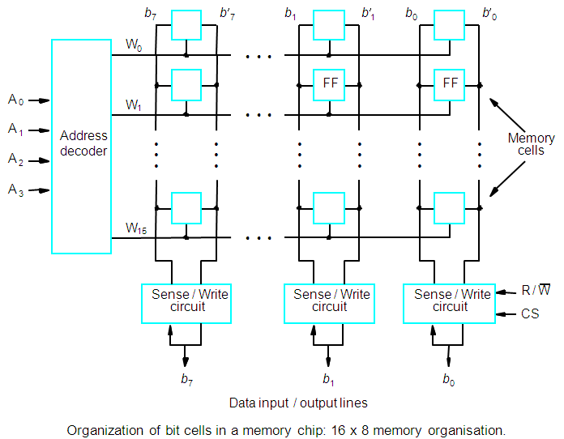
Internal organization of memory chips (Contd.,)

Slide 9
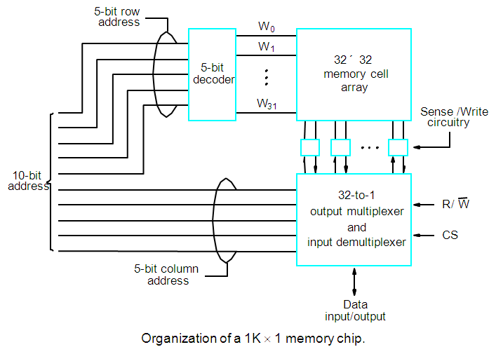
A Memory Chip

Slide 10
1K X 1 Memory chip
1K memory cells can store 1024 bits and can be organised as:
128 x 8 memory organization, external connections: 19 = (7 A + 8 D + 2 C + 2 P/G)
1K x 1 memory organization, external connections: 15 = (10 A + 1 D + 2 C +2 P/G)
1K x 1 memory organization
The 10-bit address is divided into two groups of 5 bits each to form the row and column addresses for the cell array.
A row address selects a row of 32 cells, all of which are accessed in parallel.
One of these, selected by the column address, is connected to the external data lines by the input and output multiplexers.

Slide 11
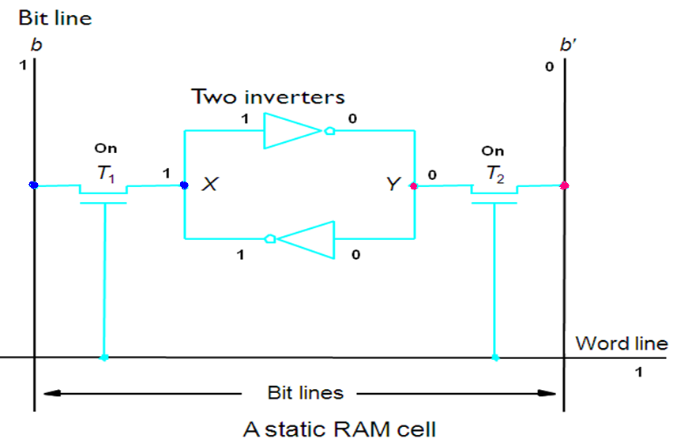
Static Memories
The circuits are capable of retaining their state as long as power is applied. When word line is at ground level transistors are turned off, and latch retains its state

Slide 12
SRAM Cell
Two transistor inverters are cross connected to implement a basic flip-flop.
The cell is connected to one word line W_{i} and two bit lines b and b’ by transistors T1 and T2
When word line is at ground level, the transistors are turned off and the latch retains its state
Read operation:
  Word line is activated – to close switches T1 and T2
  If cell is in state 1, the signal on bit line b is high and signal on bit line b’ is low
  Opposite holds if cell is in state 0
  Sense/Write circuits at the end of the bit lines monitor the states of b and b’ and sets output
  Write operation:
  State of the cell is set by placing appropriate value on bit line b and b’ and then word line is activated
  This forces the cell into corresponding state
  Required signals on bit lines are generated by Sense/Write circuit

Slide 13
Typical SRAM Organization: 16-word x 4-bit
Din 3
Din 2
Din 1
Din 0
WrEn
Precharge
Wr Driver &
Precharger
Wr Driver &
Precharger
Wr Driver &
Precharger
Wr Driver &
Precharger
-
+
-
+
-
+
-
+
Word 0
A0
SRAM
Cell
SRAM
Cell
SRAM
Cell
SRAM
Cell
A1
Address Decoder
Word 1
A2
SRAM
Cell
SRAM
Cell
SRAM
Cell
SRAM
Cell
A3
:
:
:
:
Word 15
SRAM
Cell
SRAM
Cell
SRAM
Cell
SRAM
Cell
-
+
-
+
-
+
-
+
Sense Amp
Sense Amp
Sense Amp
Sense Amp
Dout 3
Dout 2
Dout 1
Dout 0
Notes:
This picture shows you how to connect the SRAM cells into a 15-word by 4-bit SRAM array.
The word lines are connected horizontally to the address decoder while the bit lines are connected vertically to the sense amplifier and write driver.
**** What do you think is longer? Word line or bit line ****
Since a typical SRAM will have thousands if not millions of words (vertical) and usually be less than 10s of bits, the bit line will be much much much longer than the word line.
This is bad because if we have a large load on the word line (large capacitance), we can always build a bigger address decoder to drive them no sweat.
But for the bit lines, we still have to rely on the tiny transistors (SRAM cell). That’s why we need to precharge them to high and use sense amp to detect the differences.
Read enable is not needed here because if Write Enable is not asserted, read is by default.(Don’t need Read Enable)
The internal logic will detect an address changes and precharge the bit lines. Once the bit lines are precharged, the values of the new address will appear at the Dout pin.
+2 = 32 min. (Y:12)

Slide 14
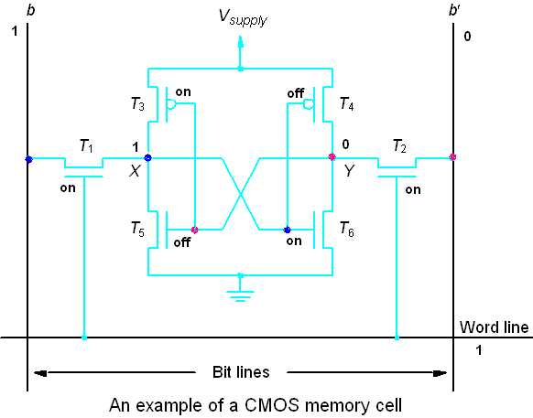
Static Memories
CMOS cell: low power consumption

Slide 15
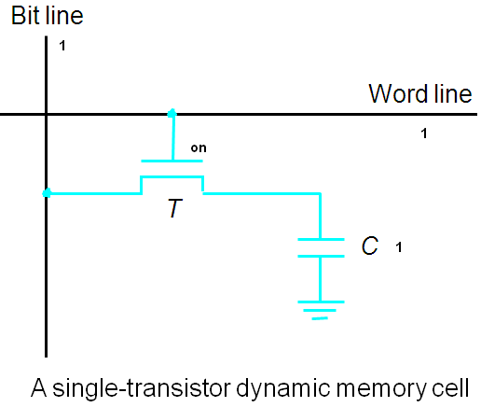
DRAMs
Static RAMs are fast, but they cost more area and are more expensive.
Dynamic RAMs (DRAMs) are cheap and area efficient, but they cannot retain their state indefinitely.
Information stored in the form of charge on a capacitor can be maintained only for tens of milliseconds. Contents must be periodically refreshed.

Slide 16
1-Transistor Memory Cell (DRAM)
row select
Write:
  1. Drive bit line
  2.. Select row
Read:
  1. Precharge bit line to Vdd
  2.. Select row
  3. Cell and bit line share charges
    Very small voltage changes on the bit line
  4. Sense (fancy sense amp)
    Can detect changes of ~1 million electrons
  5. Write: restore the value
Refresh
  1. Just do a dummy read to every cell.
bit
T
Notes:
The state of the art DRAM cell only has one transistor. The bit is stored in a tiny transistor.
The write operation is very simple. Just drive the bit line and select the row by turning on this pass transistor.
For read, we will need to precharge this bit line to high and then turn on the pass transistor.
This will cause a small voltage change on the bit line and a very sensitive amplifier will be used to measure this small voltage change with respect to a reference bit line.
Once again, the value we stored will be destroyed by the read operation so an automatic write back has to be performed at the end of every read.
+ 2 = 48 min. (Y:28)

Slide 17
Static vs Dynamic RAM
Static RAM
Bits stored as on/off switches via flip-flops
No charges to leak
No refreshing needed when powered
More complex construction
Larger per bit
More expensive
Does not need refresh circuits
Faster
Cache
Dynamic RAM
Bits stored as charge in semiconductor capacitors
capacitor charge leaks
Need refreshing even when powered
Simpler construction
Smaller per bit
Less expensive
Need refresh circuits (every few milliseconds)
Slower
Main memory

Slide 18
Asynchronous DRAMs
A 16-Mbit DRAM chip, configured as 2M X 8 memory organisation
The cells are organized as 4K X 4K array
The 4096 cells in each row are divided into 512 groups of 8 = (512 bytes)
- 12 bits to select a row, and 9 bits to select a group ( 8 bits) in a row. Total of 21 bits.
First apply the row address, RAS signal latches the row address. Then apply the column address, CAS signal latches the address.
Timing of the memory unit is controlled by a specialized unit which generates RAS and CAS.
This is asynchronous DRAM

Slide 19
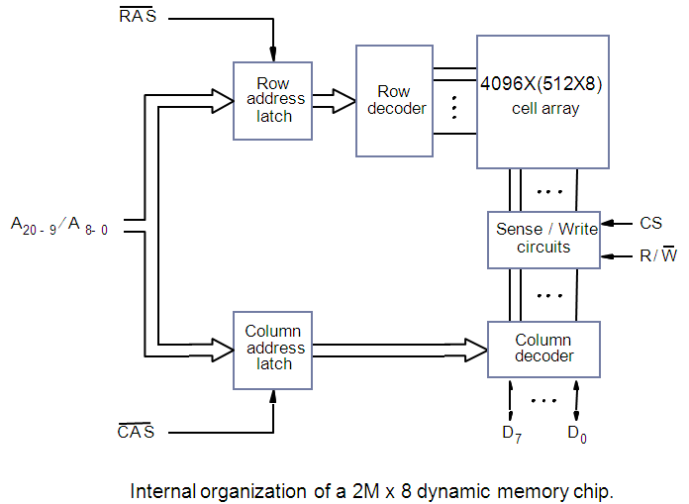
Asynchronous DRAMs

Slide 20
Fast Page Mode
When the DRAM in last slide is accessed, the contents of all 4096 cells in the selected row are sensed, but only 8 bits are placed on the data lines D7-0, as selected by A8-A0.
Suppose if we want to access the consecutive bytes in the selected row.
This can be done without having to reselect the row.
  Add a latch at the output of the sense circuits in each row.
  All the latches are loaded when the row is selected.
  Different column addresses can be applied to select and place different bytes on the data lines.
Consecutive sequence of column addresses can be applied under the control signal CAS, without reselecting the row.
  Allows a block of data to be transferred at a much faster rate than random accesses.
  A small collection/group of bytes is usually referred to as a block.
This transfer capability is referred to as the fast page mode feature.
Good for bulk transfer

Slide 21
Synchronous DRAMs
Operation is directly synchronized with processor clock signal.
The cell array is the same as in Asynchronous DRAMs.
The address and data connections are buffered by means of registers.
The outputs of the sense circuits are connected to a latch.
During a Read operation, the contents of the cells in a row are loaded onto the latches.
During a refresh operation, the contents of the cells are refreshed without changing the contents of the latches.
Data held in latches corresponding to the selected columns are transferred to data output register.
For a burst mode of operation, successive columns are selected using column address counter and clock.
CAS signal need not be generated externally. A new data is placed during raising edge of
the clock.

Slide 22
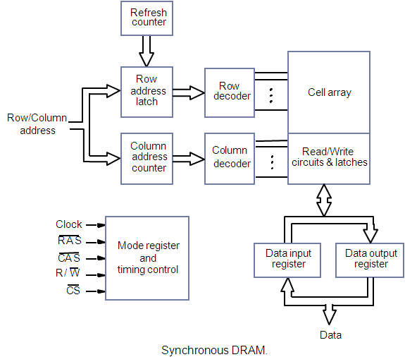
Synchronous DRAMs

Slide 23
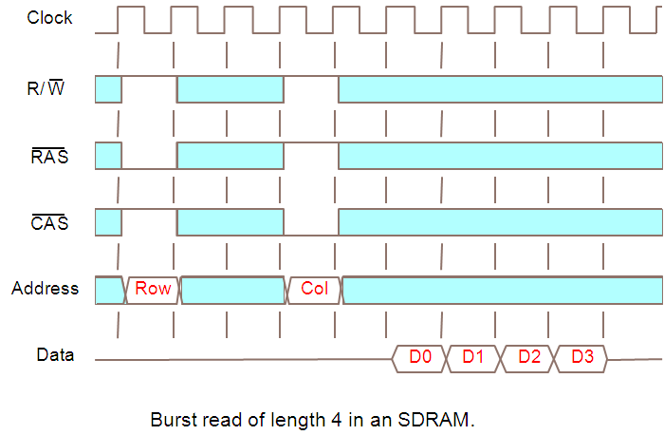
Synchronous DRAMs

Slide 24
Synchronous DRAMs
SDRAMs have several different modes of operation
  Selected by writing control information into a mode register
  Can specify burst operations of different lengths
In SDRAMs, it is not necessary to provide externally generated pulses on the CAS line to select successive columns
  Necessary signals are provided using a column counter and clock signal
  Hence new data can be placed on data lines at each clock cycle
  All actions triggered by rising edge of the clock
Row address latched under control of RAS signal
  Memory takes about 2-3 cycles to activate selected row
Column address is latched under control of CAS signal
After delay of 1 cycle, first set of data bits placed on data lines
  SDRAM automatically increments column address to access the next 3 sets of bits in the selected row, placed on data lines in successive clock cycles
SDRAMs have built in refresh circuitry
  Provides the addresses of rows that are selected for refreshing
  Each row must be refreshed at least every 64ns

Slide 25
Latency
The speed and efficiency of data transfers among memory, processor, and disk have a large impact on the performance of a computer system.
Memory latency – the amount of time it takes to transfer a word of data to or from the memory.
  In block transfers, latency is used to denote the time it takes to transfer the first word of data
    This is longer than the time needed to transfer each subsequent word of a block
  In previous diagram, access cycle begins with assertion of RAS and first word is transferred 5 cycles later.
    Hence latency is 5 clock cycles.

Slide 26
Bandwidth
Memory bandwidth – the number of bits or bytes that can be transferred in one second. It is used to measure how much time is needed to transfer an entire block of data.
Depends on:
  Speed of memory access
  Transfer capability of the links – speed of the bus
  No of bits that can be accessed in parallel
Bandwidth is not determined solely by memory. It is the product of the rate at which data are transferred (and accessed) and the width of the data bus.

Slide 27
DDR SDRAM
Standard SDRAM performs all actions on the rising edge of the clock signal.
Double-Data-Rate SDRAM
DDR SDRAM accesses the cell array in the same way, but transfers the data on both edges of the clock.
The latency is the same as standard SDRAMs
But since they transfer data on both the edges of clock, bandwidth is essentially doubled for long burst transfers
The cell array is organized in two banks, each can be accessed separately. Consecutive words of a given block are stored in different banks. Such interleaving of words allow simultaneous access to two words that are transferred on successive edges of clock.
  DDR SDRAMs and standard SDRAMs are most efficiently used in applications where block transfers are prevalent. (Eg., main memory to and from processor caches )
address
address
address
address
0
1
2
3
4
5
6
7
8
9
10
11
12
13
14
15
Bank 0
Bank 1
Bank 2
Bank 3

Slide 28
Structure of larger memories
Memory systems connected to form larger memories
There are 2 types of memory systems
  Static memory systems
  Dynamic memory systems

Slide 29
Structure of larger memories- Static Memory systems
Implementation of 2M X 32 memory using sixteen 512K X 8 static memory chips
There are 4 columns, each column containing 4 chips to implement one byte position
Only selected chips ( chip select =1) place data on output lines, outputs of other chips are in high impedance state.
21 address bits are needed to select a 32 bit word in this memory
Higher order 2 bits used to determine which of the 4 chip select signals should be activated
19 bits used to access specific byte locations inside each chip of selected row
R/W inputs of each chip are tied together to form a single R/W signal

Slide 30
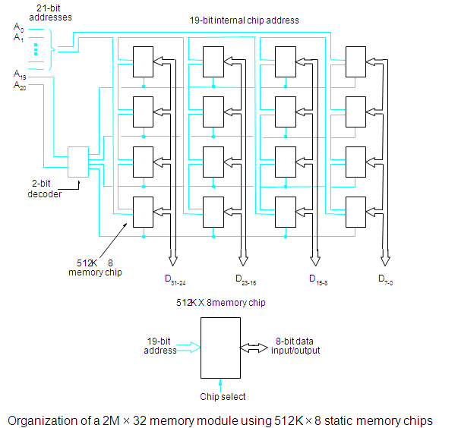
Structure of Larger Memories -Static Memories

Slide 31
Structure of Larger Memories - Dynamic memories
Large dynamic memory systems can be implemented using DRAM chips in a similar way to static memory systems.
Placing large memory systems directly on the motherboard will occupy a large amount of space.
  Also, this arrangement is inflexible since the memory system cannot be expanded easily.
Physical implementation more conveniently done in the form of memory modules
Packaging considerations have led to the development of larger memory units known as SIMMs (Single In-line Memory Modules) and DIMMs (Dual In-line Memory Modules).
Memory modules are an assembly of memory chips on a small board that plugs vertically onto a single socket on the motherboard.
  Occupy less space on the motherboard.
  Allows for easy expansion by replacement.

Slide 32
Memory System Considerations
The choice of a RAM for a given system depends on several factors
  Cost
  Speed
  Power dissipation
  Size of chip
Static RAMs are used when very fast operation is the primary requirement
  Used mostly in cache memories
Dynamic RAMs are predominant choice for computer main memories
  High densities achievable make larger memories economically feasible

Slide 33
Memory controller
Recall that in a dynamic memory chip, to reduce the number of pins, multiplexed addresses are used.
Address is divided into two parts:
  High-order address bits select a row in the array.
  They are provided first, and latched using RAS signal.
  Low-order address bits select a column in the row.
  They are provided later, and latched using CAS signal.
However, a processor issues all address bits at the same time.
In order to achieve the multiplexing, memory controller circuit
is inserted between the processor and memory.

Slide 34
Memory controller (contd..)
Row/Column
Address
address
R
A
S
R
/
W
Memory
C
A
S
Request
controller
R
/
W
Processor
Memory
C
S
Clock
Clock
Data
Use of a memory controller

Slide 35
Memory controller functions
Interposed between processor and memory
Processor sends Request signal
  Accepts complete address and R/W signal from the processor
The controller forwards the row and column portions of address to the memory
  Generates the RAS and CAS signals
Also sends R/W and CS signals to the memory
Data lines are directly connected between the processor and the memory
When used with DRAM chips, the memory controller provides all the information needed to control the refreshing process
  Contains a refresh counter – to refresh all rows within the time limit specified for a device

Slide 36
Memory System Considerations
The choice of a RAM chip for a given application depends on several factors: Cost, speed, power, size…
SRAMs are faster, more expensive, smaller (cache)
DRAMs are slower, cheaper, larger (main memory)
Refresh overhead – suppose a SDRAM whose cells are in 8K rows;
4 clock cycles are needed to access each row;
then it takes 8192 × 4 = 32,768 cycles to refresh all rows;
if the clock rate is 133 MHz, then it takes 32,768 / (133×10⁻⁶) = 246×10⁻⁶ sec;
suppose the typical refreshing period is 64 ms, then the refresh overhead is 0.246/64 = 0.0038, which is less than 0.4% of the total time for accessing the memory.

Slide 37
Read-Only Memories (ROMs)
SRAM and SDRAM chips are volatile:
  Lose the contents when the power is turned off.
Many applications need memory devices to retain contents after the power is turned off.
  For example, computer is turned on, the operating system must be loaded from the disk into the memory.
  Store instructions which would load the OS from the disk.
  Need to store these instructions so that they will not be lost after the power is turned off. (store the instructions into a non-volatile memory).
Non-volatile memory is read in the same manner as volatile memory.
  Separate writing process is needed to place information in this memory.
  Normal operation involves only reading of data, this type of memory is called Read-Only memory (ROM).
  Permanent storage , Microprogramming, Library subroutines,
  Systems programs (BIOS), Function tables

Slide 38
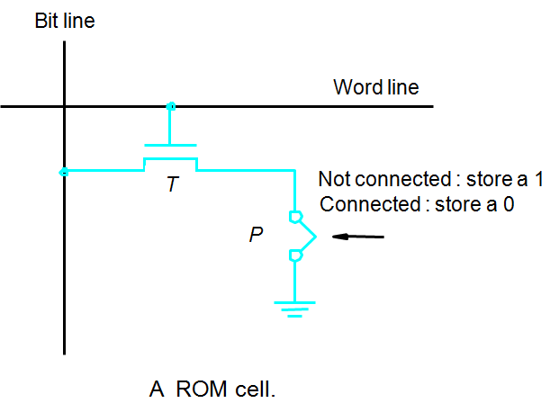
ROM
Transistor is connected to ground at point P then 0 is stored, Else 1 is stored
Bit line connected to a power supply through a resistor
To read, word line is activated , If voltage drops down => then 0,
If voltage remains same => then 1

Slide 39
Read-Only Memories (Contd.,)
Read-Only Memory:
  Data are written into a ROM when it is manufactured.
Programmable Read-Only Memory (PROM):
  Allow the data to be loaded by a user. (write only once, read many)
  Achieved by inserting a fuse at point P in the previous figure
  Before it is programmed, memory contains all 0s
  The user can insert 1at required locations using high-current pulses
  Process of inserting the data is irreversible.
  Storing information specific to a user in a ROM is expensive.
  Needs special equipment to program
  Providing programming capability to a user may be better.

Slide 40
Read-Only Memories (Contd.,)
Erasable Programmable Read-Only Memory (EPROM):
  Allows the stored data to be erased and new data to be loaded
  Erasable, reprogrammable ROM – called as EPROM
  Can be used when memory is being developed, So that it can accommodate changes
  Cell similar to ROM, connection to ground is always made at point P
  A special transistor is used – ability to function either as a normal transistor or as a disabled transistor which is always turned off
  Can be programmed to behave as permanently open switch
  Can erase by exposing the chip to UV light which dissipate the charges trapped in transistor memory cells
  Flexibility, useful during the development phase of digital systems.
  Disadvantage of EPROMs
  Chip must be physically removed from the circuit for reprogramming
  Entire contents are erased from UV light

Slide 41
Read-Only Memories (Contd.,)
Electrically Erasable Programmable Read-Only Memory (EEPROM):
version of Erasable PROM that can be both programmed and erased electrically
  Need not be removed for erasure
  Can erase cell contents selectively
  Disadvantage of EEPROM
  Different voltages needed for erasing , writing and reading stored data
  Takes much longer to write than read

Slide 42
Flash memory:
A flash cell is based on a single transistor controlled by trapped charge
  Has similar approach to EEPROM.
  Read the contents of a single cell, but write the contents of an entire block of cells
  Erase whole memory electrically.
  Flash devices have greater density, Low power
  Used in portable equipment that is battery driven – handheld computers, cell phones, digital cameras, MP3 players
    Higher capacity and low storage cost per bit.
  Power consumption of flash memory is very low, making it attractive for use in equipment that is battery-driven.

Slide 43
Flash Cards and Flash Drives
Single flash chips do not provide sufficient storage capacity
Larger memory modules are required – flash cards and flash drives
Flash cards
  Mount flash chips on a small card
  A card is simply plugged into a conveniently accessible slot
  Variety of sizes
Flash Drives
  Larger modules to replace hard disk drives
  Designed to fully emulate hard disks – not yet possible
  Storage capacity is significantly lower
  Have shorter seek and access times hence faster response
  Lower power consumption
  Insensitive to vibration

Slide 44
Speed, Size, and Cost
A big challenge in the design of a computer system is to provide a sufficiently large memory, with a reasonable speed at an affordable cost.
Static RAM:
  Very fast, but expensive, because a basic SRAM cell has a complex circuit making it impossible to pack a large number of cells onto a single chip.
Dynamic RAM:
  Simpler basic cell circuit, hence are much less expensive, but significantly slower than SRAMs.
Magnetic disks:
  Storage provided by DRAMs is higher than SRAMs, but is still less than what is necessary.
  Secondary storage such as magnetic disks provide a large amount
  of storage, but is much slower than DRAMs.

Slide 45
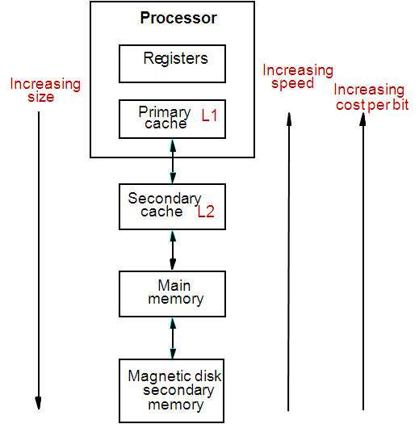
Memory Hierarchy
Fastest access is to the data held in processor
registers. Registers are at the top of the
memory hierarchy.
Relatively small amount of memory that can
be implemented on the processor chip.
This is processor cache.
Two levels of cache. Level 1 (L1) cache is on
the processor chip. Level 2 (L2) cache is in
between main memory and processor.
Next level is main memory, implemented
as SIMMs. Much larger, but much slower
than cache memory.
Next level is magnetic disks. Huge amount of
inexpensive storage.
Speed of memory access is critical, the idea is
to bring instructions and data that will be used
in the near future as close to the processor as
possible.

Slide 46
Cache Memories
Processor is much faster than the main memory.
  As a result, the processor has to spend much of its time waiting while instructions and data are being fetched from the main memory.
  Major obstacle towards achieving good performance.
  Speed of the main memory cannot be increased beyond a certain point.
Cache is a small amount of fast memory, between larger, slower main memory and the CPU , may be located on CPU chip or module to reduce the memory access time
Two levels of cache: Level 1 (L1) cache on the processor chip. Level 2 (L2) cache is in between main memory and processor.
Holds the currently active segments of a program and its data.
Cache memory is based on the property of computer programs known as “locality of reference”.
An entire block of data is copied from memory to the cache because the principle of locality tells us that once a byte is accessed, it is likely that a nearby data element will be needed soon.
CPU finds the relevant information mostly in the cache memory itself (cache hit)
infrequently needs access to the main memory (cache miss)
With suitable size of the cache memory, cache hit rates of over 90% are possible

Slide 47
Locality of Reference
Analysis of programs indicates that many instructions in localized areas of a program are executed repeatedly during some period of time, while the others are accessed relatively less frequently.
  These instructions may be the ones in a loop, nested loop or few procedures calling each other repeatedly. This is called “locality of reference”.
Temporal locality of reference:
  Recently executed instruction is likely to be executed again very soon.
  Programs tend to reference the same memory locations at a future point in time
  Due to loops and iteration, programs spending a lot of time in one section of code
Spatial locality of reference:
  Instructions with addresses close to a recently executed instruction are likely to
  be executed soon.
  Programs tend to reference memory locations that are near other recently referenced memory locations
  Due to the way contiguous memory is referenced ( e.g. an array or the instructions that make up a program)
  Sequential Locality - Instructions tend to be accessed sequentially

Slide 48

Cache memories
Processor issues a Read request, a block of words is transferred from the main memory to the cache, one word at a time.
Cache block or cache line – contiguous address locations of some size
Subsequent references to the data in this block of words are found in the cache.
At any given time, only some blocks in the main memory are held in the cache.
Mapping function – determines which blocks in the main memory are residing in the cache
When the cache is full, and a block of words needs to be transferred from the main memory, some block of words in the cache must be replaced. This is determined by a “replacement algorithm”.

Slide 49
Cache operation - overview
CPU requests contents of memory location
Check cache for this data
If present (hit) , get from cache (fast)
If not present (miss), read required block from main memory to cache
Then deliver from cache to CPU
Cache includes tags to identify which block of main memory is in each cache slot

Slide 50
Cache hit
Existence of a cache is transparent to the processor. The processor issues Read and Write requests in the same manner.
  A cache hit is when data is found in cache – read hit / write hit
  A cache miss is when data is not found – read miss / write miss
Read hit:
  The data is obtained from the cache if Cache block is valid , has proper address.
  Main memory not involved
Write hit:
  Cache has a replica of the contents of the main memory.
  Contents of the cache and the main memory may be updated simultaneously. This is the write-through protocol.
  Update the contents of the cache, and mark it as updated by setting a bit known as the dirty bit or modified bit. The contents of the main memory are updated when this block is replaced. This is write-back or copy-back protocol.

Slide 51
Cache miss
If the data is not present in the cache, then a Read miss or Write miss occurs.
Read miss:
  Block of words containing this requested word is transferred from the memory.
  After the block is transferred, the desired word is forwarded to the processor.
  The desired word may also be forwarded to the processor as soon as it is transferred without waiting for the entire block to be transferred. This is called load-through or early-restart.
Write-miss:
  If write-through protocol is used, then the contents of the main memory are
  updated directly.
  If write-back protocol is used, the block containing the addressed word is first
  brought into the cache. The desired word is overwritten with new information.

Slide 52
Cache Coherence Problem
A bit called as “valid bit” is provided for each block.
If the block contains valid data, then the bit is set to 1, else it is 0.
Valid bits are set to 0, when the power is just turned on.
When a block is loaded into the cache for the first time from main memory, the valid bit is set to 1.
Case 1:Data transfers between main memory and disk occur directly bypassing the cache by DMA transfer. When the data on a disk modified, the main memory block also get updated by DMA. However, if the data is resident in the cache also, copies of the data in the cache, and the main memory are different. This is called the cache coherence problem.
Solution: set the valid bit of that cache block to 0 indicating it is stale and prevent it from being used.
Case 2: Data in the cache modified and the write-back protocol is being used and DMA transfer from memory to disk going to take place
In this case, the data in the cache may have changed and is indicated by the dirty bit. The copies of the data in the cache, and the main memory are different (cache coherence problem).
Solution: force a write-back before the disk is updated from the main memory by DMA transfer so that updated data alone is transferred.

Slide 53
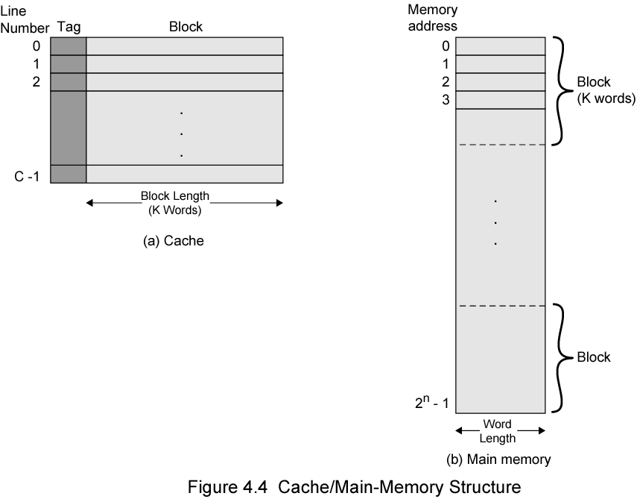
Cache/ Main Memory Structure

Slide 54
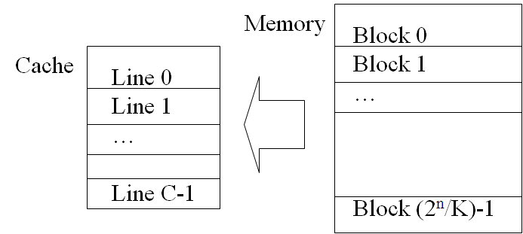
Cache Design
If memory contains 2^{n} addressable words
  Memory can be broken up into blocks with K words per block. Number of blocks = 2^{n} / K
  Cache consists of C lines or slots, each consisting of K words
  C << M
  How to map blocks of memory to lines in the cache?

Slide 55
Mapping functions
Mapping functions determine how memory blocks are placed in the cache.
Eg A processor with main memory addressable by a 16-bit address and a cache of size 2048
Main memory addressable by a 16-bit address
  Size of Main memory = 2¹⁶ = 64K words
  Size of a block = 2⁴ = 16 words
  No of blocks in Main memory = (2¹⁶ / 2⁴ ) = 2¹² = 4K = 4096 blocks of 16 words each.
  Size of cache is 2048 (= 2K = 2¹¹) words
  No of blocks in Cache = (2¹¹ / 2⁴ ) = 2⁷ = 128 blocks of 16 words each
Three mapping functions:
  Direct mapping
  Associative mapping
  Set-associative mapping.

Slide 56
Direct mapping
Simplest mapping technique - each block of main memory maps to only one cache line - i.e. if a block is in cache, it must be in one specific place
Formula to map a memory block to a cache line or cache block:
Cache block no = memory block no % number of cache lines or blocks (remainder) b = j mod c
More than one memory block is mapped onto the same position in the cache.
mem blocks - 0,128,256… 3968 maps to cache block 0,
mem blocks- 1, 129,257… 3969 maps to cache block 1,
mem blocks - 127,255….4095 maps to cache block 31.
4096/128 => 32 memory blocks map to one cache block
To identify currently which memory block is in cache block, tag bits are attached to each block, Tag no = memory block no / number of cache lines or blocks (quotient)
May lead to contention for cache blocks even if the cache is not full.
  If a program accesses 2 blocks that map to the same line repeatedly, cache misses are very high (thrashing)
Resolve the contention by allowing new block to replace the old block, leading to a trivial replacement algorithm.
Simple to implement , Inexpensive ,but not very flexible

Slide 57
Direct mapping
Main
Block j of the main memory maps to j modulo 128 block of cache.
Memory address divided into three fields:
4 word bits – which one of 16 words (each block has 16=2⁴ words)
7 block bits – to which cache line or block to place this memory block (128=2⁷)
b = j mod c
5 tag bits - compared with the tag bits associated with its location in the cache. Identify which one of 32 blocks ( =2⁵) is currently resident in the cache
t = j / c
memory
Block 0
Cache
Block 1
tag
Block 0
tag
Block 1
Block 127
Block 128
tag
Block 127
Block 129
T
ag
Block
W
ord
Block 255
5
7
4
Block 256
Main memory address
Block 257
Block 4095

Slide 58
Direct Mapping
T
ag
Block
W
ord
5
7
4
Main memory address
11101,1111111,1100
Tag: 11101
Block: 1111111=127, in the 127th block of the cache
Word:1100=12, the 12th word of the 127th block in the cache

Slide 59
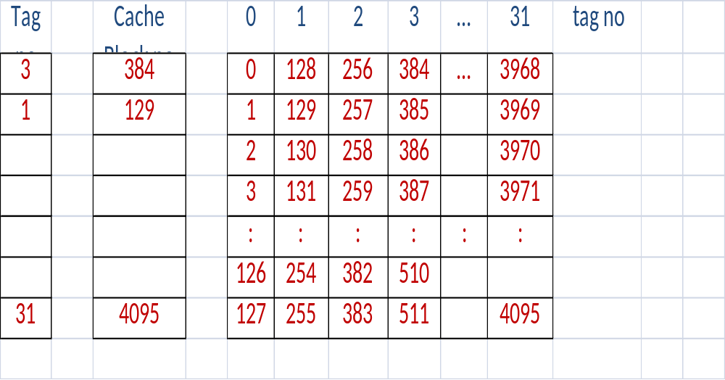
Direct Mapping

Slide 60
Fully Associative Mapping
A fully associative mapping scheme can overcome the problems of the direct mapping scheme
  A main memory block can load into any line of cache
  Memory address is interpreted as tag and word
  Tag uniquely identifies block of memory
  Every line’s tag is examined for a match
  Also need a Dirty and Valid bit
Flexible, and uses cache space efficiently.
All slots searched in parallel for target
But Cache searching gets expensive!
  Ideally need circuitry that can simultaneously examine all tags for a match
  Lots of circuitry needed, high cost
Need replacement policies now that anything can get thrown out of the cache

Slide 61
Associative mapping
Main
Block 0
memory
Cache
Block 1
tag
Block 0
tag
Block 1
Memory address divided into two fields:
4 word bits - which one of 16 words (each block has 16=2⁴ words)
12 tag bits - Identify which one of the 4096 blocks (4096=2¹² ) is currently resident in the cache block.
Block 127
Block 128
tag
Block 127
Block 129
Tag
Word
Block 255
12
4
Block 256
Main memory address
Block 257
Block 4095

Slide 62
Associative Mapping
T
ag
W
ord
12
4
Main memory address
111011111111,1100
Tag: 111011111111
Word: 1100=12,
12th word of a block in the cache

Slide 63
Set Associative Mapping
Compromise between fully-associative and direct-mapped cache
  Cache is divided into a number of sets
  Each set contains a number of cache lines or blocks
  A given block maps to any line in a specific set
    Use direct-mapping to determine which set in the cache corresponds to a set in memory
    Memory block could then be in any line of that set
  e.g. 2 lines per set (2 way associative mapping)
    A given block can be in either of 2 lines in a specific set
  e.g. K cache lines or blocks per set
    K way associative mapping
    A given block can be in one of K lines in a specific set
    Much easier to simultaneously search one set than all lines

Slide 64
Set Associative Mapping
Set-associative mapping combination of direct and associative mapping.
Blocks of cache are grouped into sets.
Mapping function allows a block of the main memory to reside in any block of a specific set.
Number of blocks per set is a design parameter.
One extreme is to have all the blocks in one set, requiring no set bits
(fully associative mapping).
Other extreme is to have one block per set, is same as direct mapping
No of blocks per set = set size = k (k-way associative)
No of cache sets = No of cache blocks / k
Set No = memory block no % number of cache sets (remainder)
s = j mod (c /k)
Tag no = memory block no / number of cache sets (quotient)
t = j / (c/k)

Slide 65
Set-Associative mapping
Divide the cache into 64 sets, with two blocks per set.
Memory block 0, 64, 128 etc. map to block 0, and they can occupy either of the two positions.
Memory address is divided into three fields:
4 word bits: one of 16 words within a block
(each block has 16=2⁴ words)
6 set bits: points to a particular set in the cache (128/2 = 64 = 2⁶)
6 tag bits: used to check if the desired block is present in cache (4096/64 = 2⁶).
Cache
Main
memory
Block 0
tag
Block 0
Block 1
Set 0
tag
Block 1
tag
Block 2
Set 1
tag
Block 3
Block 63
Block 64
tag
Block 126
Block 65
Set 63
tag
Block 127
T
ag
Set
W
ord
Block 127
6
6
4
Block 128
Main memory address
Block 129
Block 4095

Slide 66
Cache Definitions
  Hit is when data is found at a given memory level.
  Miss is when data is not found at a given memory level..
  Hit rate is the percentage of time data is found at a given memory level.
  Miss rate is the percentage of time data is not found .
  Miss rate = 1 - hit rate.
  Hit time is the time required to access data at a given memory level.
  Miss penalty is the time required to process a miss, including the time that it takes to replace a block of memory plus the time it takes to deliver the data to the processor.

Slide 67
Memory Access Time Example
Assume that it takes 1 cycle to send the address, 15 cycles for each DRAM access and 1 cycle to send a word of data.
Assuming a cache block of 4 words and one-word wide DRAM,
miss penalty = 1 + 4x15 + 4x1 = 65 cycles
With main memory and bus width of 2 words,
miss penalty = 1 + 2x15 + 2x1 = 33 cycles.
For 4-word wide memory, miss penalty is 17 cycles. Expensive due to wide bus and control circuits.
With interleaved memory of 4 memory banks and same bus width,
miss penalty = 1 + 1x15 + 4x1 = 20 cycles.
The memory controller must supply consecutive addresses to different memory banks. Interleaving is universally adapted in high-performance computers.

Slide 68
Replacement Algorithms
Difficult to determine which blocks to kick out
Least Recently Used (LRU) block
The cache controller tracks references to all blocks as computation proceeds.
Increase / clear track counters when a hit/miss occurs

Slide 69
Replacement Algorithms
For Associative & Set-Associative Cache
  Which location should be emptied when the cache is full and a miss occurs?
  First In First Out (FIFO)
  Least Recently Used (LRU)
Distinguish an Empty location from a Full one
  Valid Bit
/ 19

Slide 70
Replacement Algorithms
CPU Reference
A
B
C
A
D
E
A
D
C
F
Miss
Miss
Miss
Hit
Miss
Miss
Miss
Hit
Hit
Miss
Cache
FIFO ➔
A
A
A
A
A
E
E
E
E
E
B
B
B
B
B
A
A
A
A
C
C
C
C
C
C
C
F
D
D
D
D
D
D
Hit Ratio = No of hits / total no of accesses
= 3 / 10 = 0.3
/ 19

Slide 71
Replacement Algorithms
CPU Reference
A
B
C
A
D
E
A
D
C
F
Miss
Miss
Miss
Hit
Miss
Miss
Hit
Hit
Hit
Miss
Cache
LRU ➔
A
B
C
A
D
E
A
D
C
F
A
B
C
A
D
E
A
D
C
A
B
C
A
D
E
A
D
B
C
C
C
E
A
Hit Ratio = No of hits / total no of accesses
= 4 / 10 = 0.4
/ 19

Slide 72
Interleaving
Divides the memory system into a number of memory modules. Each module has its own address buffer register (ABR) and data buffer register (DBR).
Arranges addressing so that successive words in the address space are placed in different modules.
When requests for memory access involve consecutive addresses, the access will be to different modules.
Since parallel access to these modules is possible, the average rate of fetching words from the Main Memory can be increased.

Slide 73
Methods of address layouts
k
bits
m
bits
Module
Address in module
MM address
m
bits
k
bits
Address in module
Module
MM address
ABR
DBR
ABR
DBR
ABR
DBR
ABR
DBR
ABR
DBR
ABR
DBR
Module
Module
Module
Module
Module
Module
0
i
n
-
1
0
i
2
k
-
1
Consecutive words are placed in a module.
High-order k bits of a memory address determine the module.
Low-order m bits of a memory address determine the word within a module.
When a block of words is transferred from main memory to cache, only one module is busy at a time.
Consecutive words are located in consecutive modules.
Consecutive addresses can be located in consecutive modules.
While transferring a block of data, several memory modules can be kept busy at the same time.

Slide 74
Hit Rate and Miss Penalty
Hit rate
Miss penalty
Hit rate can be improved by increasing block size, while keeping cache size constant
Block sizes that are neither very small nor very large give best results.
Miss penalty can be reduced if load-through approach is used when loading new blocks into cache.

